Slide 1
PHP and MySQL
Exploring the integration of PHP and MySQL for dynamic web applications.

Slide 2
Introduction
PHP and MySQL are powerful tools for building dynamic and interactive web applications.
PHP is a server-side scripting language used to create dynamic content.
MySQL is a popular database system used to store and manage data.

Slide 3
01
PHP Basics

Slide 4
What is PHP?
PHP stands for Hypertext Preprocessor
Server-side scripting language
Embedded within HTML
Widely used for web development

Slide 5

PHP Syntax Basics
Code starts with <?php and ends with ?>
In PHP, each statement must end with a semicolon (;)

Slide 6
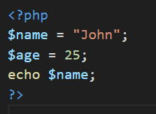
PHP Variables
What is a variable? A variable is a container for storing data (like text, numbers, etc.) in PHP
Rules for PHP Variables:
Start with a dollar sign ($)
Flowed by the variable name e.g $name
Variable names are case-sensitive
Must begin with a letter or underscore (_)
Cannot start with a number

Slide 7
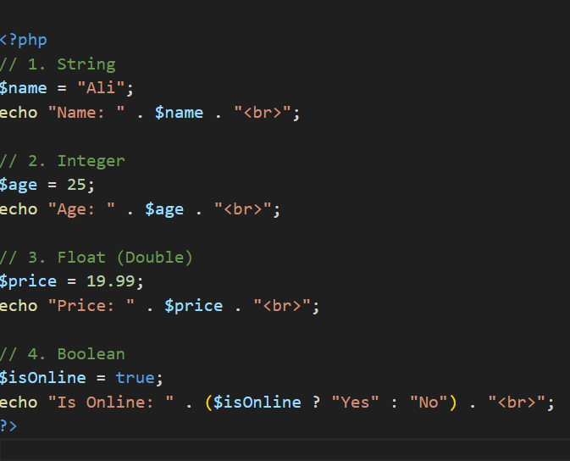
PHP Data Types
Explanation:
String: A sequence of characters
Integer: Whole number
Float: Decimal number
Boolean: Represents true of false

Slide 8
02
MySQL Basics

Slide 9
Introduction to MySQL
MySQL is an open-source relational database
Stores data in tables (rows and columns)
Works well with PHP

Slide 10
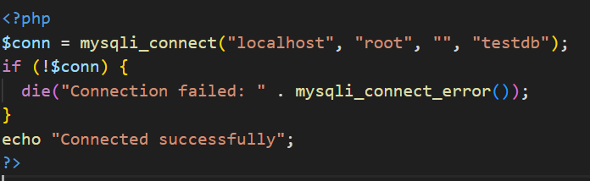
Connecting PHP to MySQL
This PHP script connects to a MySQL database using “mysqli_connect” It checks if the connection is successful and displays "Connected successfully". If it fails, it shows an error message.

Slide 11
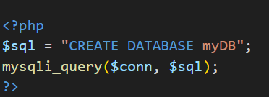
Creating a Database

Slide 12
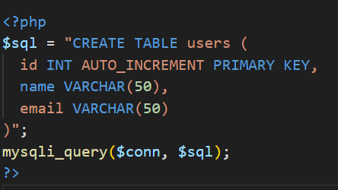
Creating a Table

Slide 13
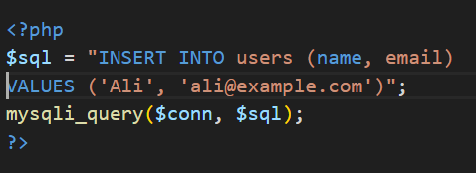
Inserting Data

Slide 14
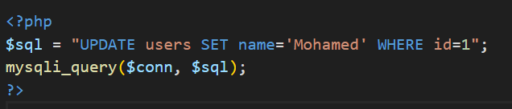
Updating Data

Slide 15
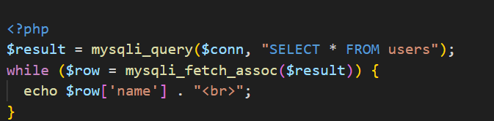
Fetching Data

Slide 16
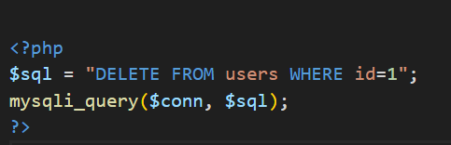
Deleting Data

Slide 17
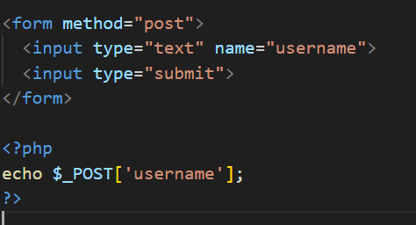
Using Forms with PHP

Slide 18
Thank you!

